Slide 1

Managing Discovery:
Rules, Common Issues & Tips
Notes:
Welcome to Discovery Management Distance Education Week 5! This week, we are discussing the ways to manage all of your discovery in a court-martial. Discovery comes in lot’s of different forms; from documents such as your ROI and preferral and referral documents, to witness lists and newly discovered evidence; there can be a lot to keep track of. If you don’t have a plan in place, you can end getting lost in a sea of documents, and may miss giving something to the defense that may have grave consequences for you trial. The intention of this presentation is to discuss some basic rules for discovery, get you thinking about places to look for discovery, give you some ideas for ways to track and manage your discovery.
*This presentation is based on a webcast given by Captain Adam Olsen and SSgt Timothy Peifer from 87 ABW/JA in August of 2012 titled “AMC Managing Discovery,” which is available on Capsil.

Slide 2
This presentation is based on a webcast given by Captain Adam Olsen and SSgt Timothy Peifer from 87 ABW/JA in August of 2012.
The webcast is titled “AMC Managing Discovery “ and is available on Capsil at:
https://aflsa.jag.af.mil/apps/jade/collaborate/mod/scorm/view.php?id=20512
if you would like to view it.

Slide 3
OVERVIEW
Discovery Rules
Obtaining Discovery
Organizing Discovery
Managing Discovery
Paralegal Benefits
Avoiding Pitfalls
Notes:
Here is what we are going to cover….

Slide 4
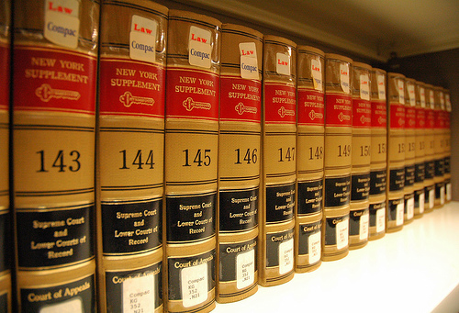
DISCOVERY RULES
Article 46: UCMJ, requires that the trial counsel, the defense counsel, and the court-martial have equal opportunity to obtain witnesses and other evidence
R.C.M. 701: TC shall provide the defense with:
  Papers accompanying charges; convening orders; statements
  Documents, Tangible Objects, Reports
  Witnesses
  Prior Convictions of the Accused
  Information to be Offered at Sentencing
  Evidence Favorable to Defense
Notes:
- Where do the rules for discovery come from? Article 46 establishes why we share, and RCM 701 tells us what to share, both from the prosecution to defense and vice-versa
- Rules of discovery are very broad and encompassing. In fact, even more so than civilian rules. CAAF has held in U.S. v. Williams, 50 MJ 436, has interpreted these rules to be more broad than the civilian rules.
-So what is the bottom line? Essentially, consider that anything in your possession, with the exception of attorney work product material is discoverable and should be turned over. If you have it, chances are the other side gets it.
- No matter how badly it hurts your case!! .

Slide 5
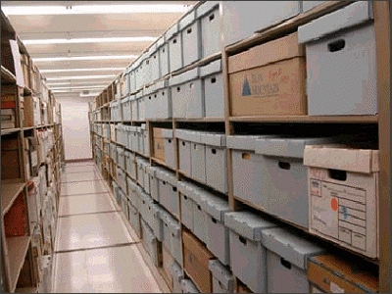
OBTAINING DISCOVERY
Report of Investigation
  Limited to what OSI determined to be important
  It will not include everything relevant or significant
OSI Case File
  With limited exceptions, the entire file is discoverable
  Contains critical information not included in the ROI.
OSI Evidence Locker
Local Civilian Prosecutor’s File
Blotter
Legal Office Files
Don’t forget Facebook!
Notes:
- There are many types of discovery out there. You need to know where to look! Your first stop will be the AFOSI ROI.
- Is it enough to simply rely solely on OSI’s ROI? Do they investigate everything and get all evidence for us? Not so fast! The most important thing to realize is that OSI has a different mission than us. While we are looking for a way to prosecute or defend someone, they are looking for facts of what happened and may not catch the little things we may need to win a case. So when it comes to the ROI, truly do use it as only a starting point.
- You need to physically GO to OSI. Put your hands on their case file, and copy the entire file, even the IDP (more to come later.) Don’t forget the agent notes!
OSI also has an evidence locker with physical evidence for your case. Look at it and go through that evidence! Could be clothing, sheets, drug paraphernalia, etc. If you don’t go see it, you may not know it exists.
Some other places to look are:
- If the case was investigated by the local authorities or DHS, FBI…make sure you get their case file, or a list of evidence from them.
- Review the blotter…may uncover other misconduct
- Legal office files may have information depending on if the person is frequent customer.
-Don’t forget Facebook/Google! You never know what someone will post on their Facebook page or what you can find in Google. It is really easy to get a screen shot or save an internet page. One thing you may want to consider though if you are TC is to have a paralegal go out and retrieve the info off of Facebook or Google so that you won’t become a witness in an Article 32 hearing or a court-martial to explain the process of how you got the inforamation.

Slide 6
OSI CASE FILE ISSUES
OSI has specific items they do not want released:
  Internal Data Pages (IDP)
  Law Enforcement/Interrogation Techniques
  Confidential Source (CS) Information/Identity
  Tradecraft Information
Internal policies of OSI do not dictate what is turned over in discovery
TC must comply with discovery rules and case law
Coordinate with OSI to redact sensitive information
Consult other attorneys and STCs to resolve issues
Notes:
- Let’s talk a little more about OSI…
- Know that OSI isn’t always going to want to provide you everything they have. Some examples are the Internal Data Page (IDP), the techniques they use to do their job, Confidential Source (CS) information, and tradecraft information.
- As a result, we need to be sensitive to information OSI wants you to protect, particularly their techniques and confidential sources. But know that OSI’s internal policies do not dictate what is turned over in discovery. Discovery is bound by the UCMJ, RCM and case law…not OSI’s regulations.
- If OSI has issues, sit down with the OSI detachment and consult other attorneys. A good way to compromise is redaction if allowed. But make sure you take good care of the information to keep the good relationship going.

Slide 7
ORGANIZING DISCOVERY
Allows for more efficient OSI/JA Teaming
  Efficient analysis of the current evidence
  Facilitates effective investigation plan
  Allows JA to advise on additional investigative steps
Facilitates Case Preparation
  Development of Trial Strategy
  Streamlines Trial Processes
Ensures all evidence is turned over to Defense
Alleviates PCS, TDY, Leave and Deployment
  Continuity → Ease of handover
Notes:
- So now that you have all of this discovery, what do you do with it? Let’s now talk about why organization is important.
- We all want to have a good working relationship with OSI, so when you have all of your discovery, hopefully before the ROI is completed, it would be a great idea to sit down with OSI and go through all that you have. It can be a good way to analyze what you have, see what OSI investigated or didn’t investigate, and gives you the chance to advise on what else they could or should investigate. This will help you to get your case ready and possibly develop a strategy.
- Why organize discovery?
- If you don’t, you just have a pile of papers with no real direction.
- Organization can help make sure defense gets all of the discovery they are entitled to.
- As a court progresses, the documents only grow. Keeping them organized gives you a place to put any new discovery that comes in.
- Adds continuity when attorneys or paralegals come and go due to PCS, TDY, leave, or deployment. When everything is organized, someone can just step in and go!
- We want to be streamlined and efficient, and organization will help that goal immensely.

Slide 8
MANAGING DISCOVERY
Keep original documents somewhere safe
As discovery is obtained make a hard copy
  Keep the master copy safe in legal office
  Allows for more copies without going to OSI
Scan each document separately
  Name the files something simple and searchable
  Include a discovery number
  Consider using a standard naming system
    Discovery Number - Form #: Name, date
Notes:
So now that you know the importance of organizing discovery, how do you do it? What do you do with your documents? Keep them somewhere safe! Paper copies are great and keeping a hard copy ensures you have the documents in case you lose your computer.
There are many ways to do this, i.e. the court reporter keeps them all, they are kept in protective sleeves, locked away in a file cabinet, etc. But be warned: If you are a paralegal, make sure the attorney doesn’t get their hands on an original document. And if you are an attorney, stay away from the original documents.
When you copy the file/evidence from various locations you have to make a hard copy…just keep it organized and don’t staple it in case you need more copies.
But have you ever considered scanning all discovery and keeping it digitally to facilitate easy sharing and storage? In this digital age, consider keeping things electronically.
Scan each document into a system and keep it organized by giving it a standard file name, and attach a number. Include a discovery number when naming files
Think how easy it would be to be able to easily go into the place you saved the files and retrieve them whenever you need them. It would be fully searchable and sortable. Additionally, you would have the ability to move them on to a government hard drive, or to another base if need be.

Slide 9
NAMING SYSTEM
For example, let’s say you have an 1168 witness statement you need to scan and save.
A suggested format would be:
  Discovery Number - Form #: Name, date
And that would look like:
  1 – 1168 Witness Statement: Doe, John, 26 Mar 13
Notes:
This is merely a suggestion, but it is one that would work well. If you do this for all of your discovery, it would be an easy way to keep it all straight.

Slide 10
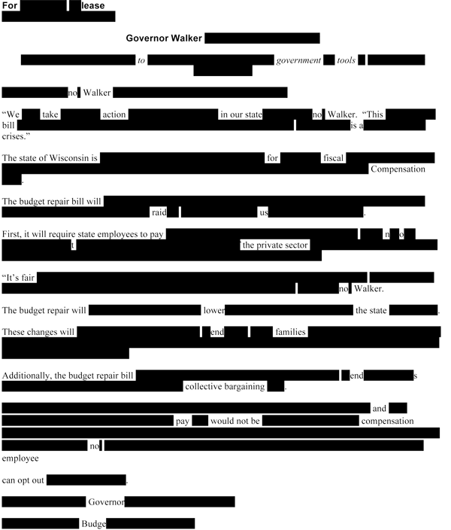
MANAGING DISCOVERY
Redact discovery as it is saved
  Guards against disclosure of protected material
  Allows quick printing at Art. 32, motion hearing, or during trial
  Helps with preparing a redacted ROT
    For the Accused
    For a victim under the new
    Article 54(e)
Redact material protected by
the Privacy Act
  Date of birth
  Social Security numbers
  Home phone/address
  Place of birth
Notes:
- There are several different ways to redact privacy act, sensitive, or protected information from a document. Two tried and true methods are the magic marker and correction tape…but did you know you can use Adobe Pro X (10) to redact your document for you, saving you time and effort? More to come on that in a bit.
- If you are using the scanning function we have talked about, in addition to saving the original document, consider redacting the discovery as it is scanned and saved. Create another file name with “Redacted” at the end, or (R).
- For example, as the 1168 we discussed earlier would be “1. – 1168 Witness Statement, Doe, John, 26 Mar 13 REDACTED”
Some benefits to having everything already redacted would be that:
It guards against the disclosure of protected material
Allows quick printing when needed
Helps with preparing a redacted ROT
So now, back to Adobe Pro X. We have been informed the USAF has bought several thousand copies of Adobe Pro X (10). This program allows you to redact documents in a convenient and easy way. Additionally, with Adobe Pro X, you can easily mark your documents for court quickly and easily: no more stamping! Please view the PowerPoint presentation entitled “Redaction and Marking in Adobe Pro X” for more information on how to use this great tool!

Slide 11
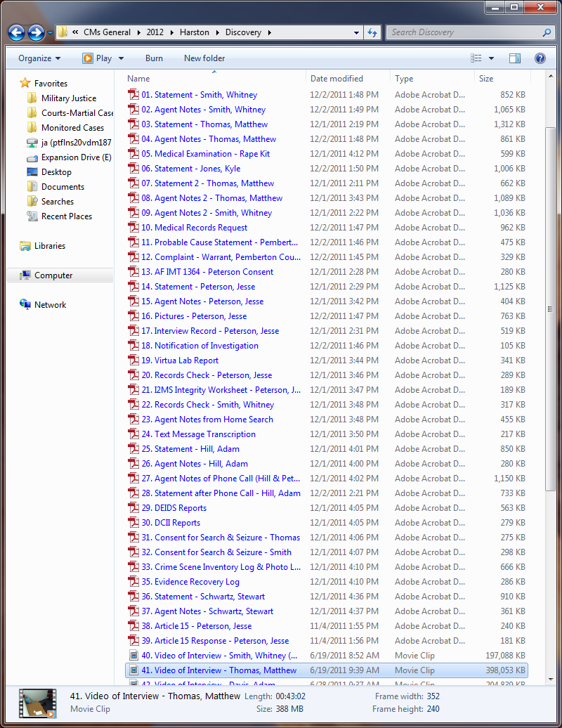
DISCOVERY MANAGEMENT
Notes:
- This screenshot shows a sample discovery folder for a relatively simple case with only a couple dozen documents.
- See the number
- The description
- The witness

Slide 12

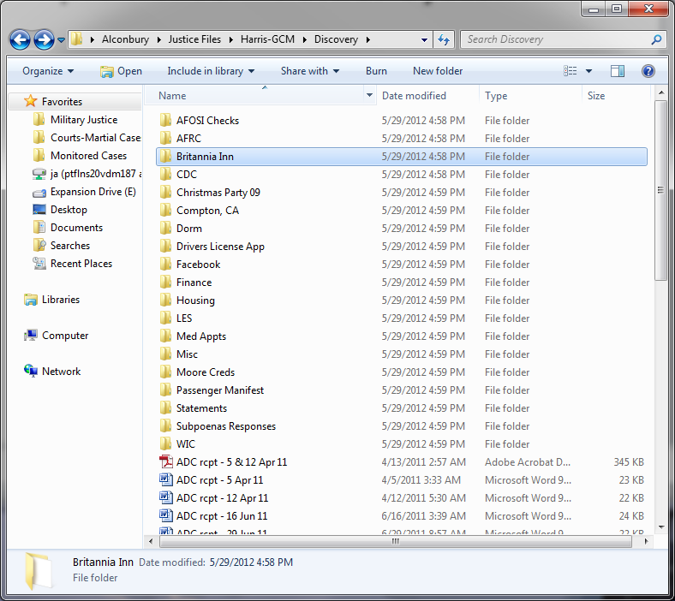
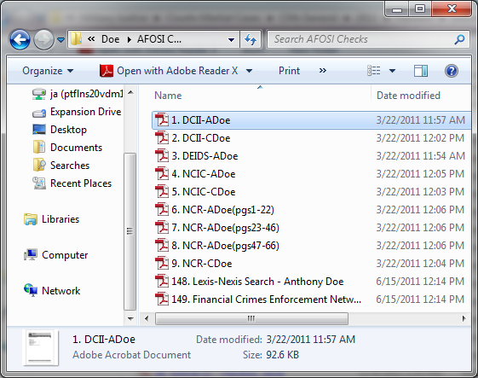
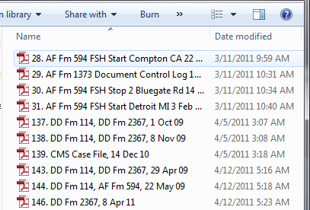
Notes:
- This example depicts a more complex case involving hundreds of documents
- Discovery folder -> Subfolders based on document
- Critical discovery management to keep organized and efficiently process a court-martial
- Lots of documents leave open the possibility of failing to disclose items to the defense.

Slide 13
DISCOVERY INDEX
Create a Discovery Index to track all of your documents
  There are several ways to create an index, but an Excel spreadsheet works great
Benefits:
  Ensures that the defense gets the discovery they are entitled to
  Simplifies the searching and referencing of evidence
    Ctrl+F in spreadsheet
  Uses software already on your computer
Notes:
- It is great that you have saved all of the documents in an easily searchable format, but what can you use to keep them all straight and ensure they go to the defense? Imagine if you had 100 discovery documents….that’s a lot of documents!
- Create a “Discovery Index” which is a tool to help find documents, track documents and ensure compliance with Art. 46 and RCM 701.
There are lots of options to keep track of discovery. In our example, it is nothing more than an Excel spreadsheet. This process is easy for any one with any level of computer to understand. Some benefits are:
- No additional cost to the office
- Uses software on your computer
- No need for training
- Uses Excel which everyone has some experience with

Slide 14
DISCOVERY INDEX
Discovery number, description, and date of document same as save name
Also add:
  How many pages the document is
  Date Provided to Defense
  If it’s a large case, the folder it is stored in
  Anything else…
Notes:
- Here are some ideas for columns in your spreadsheet:
- Use same discovery number, description, name, and date you used as your save name.
- Also add how many pages the document is, the date is was provided to the defense, and what folder in larger cases will speed up where the document actually is on your virtual system
- Date provided to defense eliminates any questions about disclosures
- Finally, anything else you may want to add. An example of an additional column for a big case would be a comments column where you could put search terms that you could use to search for the document.

Slide 15
DISCOVERY INDEX
Number | Description | Date on Exhibit | Pages | Date to Defense
1 | Statement - Smith, Whitney | 19-Jun-11 | 3 | 5-Dec-11
2 | Agent Notes - Smith, Whitney | 19-Jun-11 | 4 | 5-Dec-11
3 | Statement - Thomas, Matthew | 19-Jun-11 | 5 | 5-Dec-11
4 | Agent Notes - Thomas, Matthew | 19-Jun-11 | 4 | 5-Dec-11
5 | Medical Examination - Rape Kit | 19-Jun-11 | 3 | 5-Dec-11
6 | Statement - Jones, Kyle | 28-Jun-11 | 3 | 5-Dec-11
7 | Statement 2 - Thomas, Matthew | 11-Jul-11 | 2 | 5-Dec-11
8 | Agent Notes 2 - Thomas, Matthew | 11-Jul-11 | 5 | 5-Dec-11
9 | Agent Notes 2 - Smith, Whitney | 11-Jul-11 | 5 | 5-Dec-11
10 | Medical Records Request | 29-Jun-11 | 5 | 5-Dec-11
11 | Probable Cause Statement - Pemberton Co. | 19-Jul-11 | 2 | 5-Dec-11
12 | Complaint - Warrant, Pemberton County | 19-Jun-11 | 1 | 5-Dec-11
13 | AF IMT 1364 - Peterson Consent | 19-Jun-11 | 1 | 5-Dec-11
14 | Statement - Peterson, Jesse | 19-Jun-11 | 6 | 5-Dec-11
15 | Agent Notes - Peterson, Jesse | 19-Jun-11 | 2 | 5-Dec-11
16 | Pictures - Peterson, Jesse | - | 3 | 5-Dec-11
17 | Interview Record - Peterson, Jesse | 19-Jun-11 | 2 | 5-Dec-11
18 | Notification of Investigation | 27-Jun-11 | 1 | 5-Dec-11
19 | Virtua Lab Report | 19-Jun-11 | 3 | 5-Dec-11
20 | Records Check - Peterson, Jesse | 22-Jun-11 | 1 | 5-Dec-11
21 | I2MS Integrity Worksheet - Peterson, Jesse | - | 1 | 5-Dec-11
22 | Records Check - Smith, Whitney | 22-Jun-11 | 1 | 5-Dec-11
23 | Agent Notes from Home Search | 19-Jun-11 | 2 | 5-Dec-11
24 | Text Message Transcription | 19-Jun-11 | 3 | 5-Dec-11
25 | Statement - Hill, Adam | 19-Jun-11 | 3 | 5-Dec-11
26 | Agent Notes - Hill, Adam | 19-Jun-11 | 2 | 5-Dec-11
27 | Agent Notes of Phone Call (Hill & Peterson) | 19-Jun-11 | 6 | 5-Dec-11
28 | Statement after Phone Call - Hill, Adam | 19-Jun-11 | 3 | 5-Dec-11
29 | DEIDS Reports | - | 4 | 5-Dec-11
30 | DCII Reports | - | 3 | 5-Dec-11
31 | Consent for Search & Seizure - Thomas, Matthew | 19-Jun-11 | 1 | 5-Dec-11
32 | Consent for Search & Seizure - Smith | 19-Jun-11 | 1 | 5-Dec-11
33 | Crime Scene Inventory Log & Photo Log | 19-Jun-11 | 3 | 5-Dec-11
34 | Pictures from Photo Log (30) | - | 30 | 5-Dec-11
DISCOVERY MANAGEMENT
Notes:
- Here is an example of a Discovery index
- In many of the descriptions you can see the standard file discussed earlier.

Slide 16
DISCOVERY INDEX
Discovery Number | Evidence | Date (if applicable) | Pages | Folder Name | Date Sent to Defense
1 | DCII-Defense Central Index of Investigations, A.Doe | 12-Jan-11 | 1 | AFOSI Checks | 1-Apr-11
2 | DCII, Defense Central Index of Investigations, C.Doe | 12-Jan-11 | 1 | AFOSI Checks | 1-Apr-11
3 | DEIDS Report- A.Doe | 12-Jan-11 | 1 | AFOSI Checks | 1-Apr-11
4 | NCIC-ADoe | 12-Jan-11 | 1 | AFOSI Checks | 1-Apr-11
5 | NCIC-CDoe | 12-Jan-11 | 1 | AFOSI Checks | 1-Apr-11
6 | NCR-ADoe (pgs 1-22) | 11-Jan-11 | 22 | AFOSI Checks | 1-Apr-11
7 | NCR-ADoe (pgs 23-46) | 11-Jan-11 | 24 | AFOSI Checks | 1-Apr-11
8 | NCR-ADoe (pgs 47-66) | 11-Jan-11 | 20 | AFOSI Checks | 1-Apr-11
9 | NCR-CDoe | 11-Jan-11 | 24 | AFOSI Checks | 1-Apr-11
10 | AFRC Budget Consult, 30 Oct 09 | 17-Feb-11 | 1 | AFRC | 1-Apr-11
11 | AFRC Financial Consult, 2 Sep 09 | 17-Feb-11 | 2 | AFRC | 1-Apr-11
12 | Britannia Inn, 22 Dec 08 - 1 Feb 09 | 1-Feb-11 | 3 | Britannia Inn | 1-Apr-11
13 | RAF Alconbury CDC, 23 Sep 09 | 23-Sep-09 | 12 | CDC | 1-Apr-11
14 | Photo, Chris 1 |  | 1 | Christmas Party 09 | 1-Apr-11
15 | Photo, Chris 1 (edited) |  | 1 | Christmas Party 09 | 1-Apr-11
16 | Photo, Chris 2 |  | 1 | Christmas Party 09 | 1-Apr-11
17 | Photo, Chris 2 (edited) |  | 1 | Christmas Party 09 | 1-Apr-11
18 | Photo, Chris 3 |  | 1 | Christmas Party 09 | 1-Apr-11
19 | Photo, Chris 3 (edited) |  | 1 | Christmas Party 09 | 1-Apr-11
20 | Photo, Chris 4 |  | 1 | Christmas Party 09 | 1-Apr-11
21 | Photo, Chris 4 (edited) |  | 1 | Christmas Party 09 | 1-Apr-11
22 | Blockshopper-Nestor Ave | 15-Dec-10 | 10 | Compton, CA | 1-Apr-11
23 | Westlaw-Nestor Ave (Real Prop Transaction Record) | 15-Dec-10 | 16 | Compton, CA | 1-Apr-11
24 | AF Fm 291, Terminate Dorm Residency | 1-Oct-09 | 2 | Dorm | 1-Apr-11
25 | Dorm Resident Spreadsheet |  | 1 | Dorm | 1-Apr-11
26 | Resident Registration Form, eff 29 Apr 09 | 14-May-09 | 1 | Dorm | 1-Apr-11
27 | Chris 3AF Drivers License Application | 8-Oct-09 | 3 | Drivers License App | 1-Apr-11
28 | AF Fm 594, FSH start Compton, CA | 22-May-09 | 1 | Finance | 1-Apr-11
29 | AF Fm 1373, Document Control Log | 13-Sep-10 | 1 | Finance | 1-Apr-11
30 | AF Fm 594, FSH stop 2 Bluegate Rd, eff 5 Sep 10 | 13-Dec-10 | 1 | Finance | 1-Apr-11
31 | AF Fm 594, FSH start Detroit, MI, eff 31 Jan 11 | 3-Feb-11 | 1 | Finance | 1-Apr-11
32 | DD Fm 1764, Application for Housing | 28-Aug-09 | 1 | Housing/2 Bluegate | 1-Apr-11
33 | Lease Agreement, 8 Sep 09 | 8-Sep-09 | 2 | Housing/2 Bluegate | 1-Apr-11
34 | Lease Agreement, 8 Nov 09 | 8-Nov-09 | 2 | Housing/2 Bluegate | 1-Apr-11
DISCOVERY MANAGEMENT
Notes:
- Here is a complex case example.
- The difference is the Folder Name

Slide 17
Side-by-side View
Number | Description | Date on Exhibit | Pages | Date to Defense
1 | Statement - Smith, Whitney | 19-Jun-11 | 3 | 5-Dec-11
2 | Agent Notes - Smith, Whitney | 19-Jun-11 | 4 | 5-Dec-11
3 | Statement - Thomas, Matthew | 19-Jun-11 | 5 | 5-Dec-11
4 | Agent Notes - Thomas, Matthew | 19-Jun-11 | 4 | 5-Dec-11
5 | Medical Examination - Rape Kit | 19-Jun-11 | 3 | 5-Dec-11
6 | Statement - Jones, Kyle | 28-Jun-11 | 3 | 5-Dec-11
7 | Statement 2 - Thomas, Matthew | 11-Jul-11 | 2 | 5-Dec-11
8 | Agent Notes 2 - Thomas, Matthew | 11-Jul-11 | 5 | 5-Dec-11
9 | Agent Notes 2 - Smith, Whitney | 11-Jul-11 | 5 | 5-Dec-11
10 | Medical Records Request | 29-Jun-11 | 5 | 5-Dec-11
11 | Probable Cause Statement - Pemberton Co. | 19-Jul-11 | 2 | 5-Dec-11
12 | Complaint - Warrant, Pemberton County | 19-Jun-11 | 1 | 5-Dec-11
13 | AF IMT 1364 - Peterson Consent | 19-Jun-11 | 1 | 5-Dec-11
14 | Statement - Peterson, Jesse | 19-Jun-11 | 6 | 5-Dec-11
15 | Agent Notes - Peterson, Jesse | 19-Jun-11 | 2 | 5-Dec-11
16 | Pictures - Peterson, Jesse | - | 3 | 5-Dec-11
17 | Interview Record - Peterson, Jesse | 19-Jun-11 | 2 | 5-Dec-11
18 | Notification of Investigation | 27-Jun-11 | 1 | 5-Dec-11
19 | Virtua Lab Report | 19-Jun-11 | 3 | 5-Dec-11
20 | Records Check - Peterson, Jesse | 22-Jun-11 | 1 | 5-Dec-11
21 | I2MS Integrity Worksheet - Peterson, Jesse | - | 1 | 5-Dec-11
22 | Records Check - Smith, Whitney | 22-Jun-11 | 1 | 5-Dec-11
23 | Agent Notes from Home Search | 19-Jun-11 | 2 | 5-Dec-11
24 | Text Message Transcription | 19-Jun-11 | 3 | 5-Dec-11
25 | Statement - Hill, Adam | 19-Jun-11 | 3 | 5-Dec-11
26 | Agent Notes - Hill, Adam | 19-Jun-11 | 2 | 5-Dec-11
27 | Agent Notes of Phone Call (Hill & Peterson) | 19-Jun-11 | 6 | 5-Dec-11
28 | Statement after Phone Call - Hill, Adam | 19-Jun-11 | 3 | 5-Dec-11
29 | DEIDS Reports | - | 4 | 5-Dec-11
30 | DCII Reports | - | 3 | 5-Dec-11
31 | Consent for Search & Seizure - Thomas, Matthew | 19-Jun-11 | 1 | 5-Dec-11
32 | Consent for Search & Seizure - Smith | 19-Jun-11 | 1 | 5-Dec-11
33 | Crime Scene Inventory Log & Photo Log | 19-Jun-11 | 3 | 5-Dec-11
34 | Pictures from Photo Log (30) | - | 30 | 5-Dec-11
35 | Evidence Recovery Log | 19-Jun-11 | 1 | 5-Dec-11
36 | Statement - Schwartz, Stewart | 21-Jun-11 | 3 | 5-Dec-11
37 | Agent Notes - Schwartz, Stewart | 21-Jun-11 | 2 | 5-Dec-11
38 | Article 15 - Peterson, Jesse | 22-Sep-11 | 4 | 5-Dec-11
39 | Article 15 Response - Peterson, Jesse | 27-Sep-11 | 2 | 5-Dec-11
40 | Video of Interview - Smith, Whitney (no sound) | 19-Jun-11 | - | 5-Dec-11
41 | Video of Interview - Thomas, Matthew | 19-Jun-11 | - | 5-Dec-11
Notes:
- This example shows how the virtual folder on your share drive will match the discovery index.

Slide 18
Complex Case - Side-by-side View
Discovery Number | Evidence | Date (if applicable) | Pages | Folder Name | Date Sent to Defense
1 | DCII-Defense Central Index of Investigations, A.Doe | 12-Jan-11 | 1 | AFOSI Checks | 1-Apr-11
2 | DCII, Defense Central Index of Investigations, C.Doe | 12-Jan-11 | 1 | AFOSI Checks | 1-Apr-11
3 | DEIDS Report- A.Doe | 12-Jan-11 | 1 | AFOSI Checks | 1-Apr-11
4 | NCIC-ADoe | 12-Jan-11 | 1 | AFOSI Checks | 1-Apr-11
5 | NCIC-CDoe | 12-Jan-11 | 1 | AFOSI Checks | 1-Apr-11
6 | NCR-ADoe (pgs 1-22) | 11-Jan-11 | 22 | AFOSI Checks | 1-Apr-11
7 | NCR-ADoe (pgs 23-46) | 11-Jan-11 | 24 | AFOSI Checks | 1-Apr-11
8 | NCR-ADoe (pgs 47-66) | 11-Jan-11 | 20 | AFOSI Checks | 1-Apr-11
9 | NCR-CDoe | 11-Jan-11 | 24 | AFOSI Checks | 1-Apr-11
10 | AFRC Budget Consult, 30 Oct 09 | 17-Feb-11 | 1 | AFRC | 1-Apr-11
11 | AFRC Financial Consult, 2 Sep 09 | 17-Feb-11 | 2 | AFRC | 1-Apr-11
12 | Britannia Inn, 22 Dec 08 - 1 Feb 09 | 1-Feb-11 | 3 | Britannia Inn | 1-Apr-11
13 | RAF Alconbury CDC, 23 Sep 09 | 23-Sep-09 | 12 | CDC | 1-Apr-11
14 | Photo, Chris 1 |  | 1 | Christmas Party 09 | 1-Apr-11
15 | Photo, Chris 1 (edited) |  | 1 | Christmas Party 09 | 1-Apr-11
16 | Photo, Chris 2 |  | 1 | Christmas Party 09 | 1-Apr-11
17 | Photo, Chris 2 (edited) |  | 1 | Christmas Party 09 | 1-Apr-11
18 | Photo, Chris 3 |  | 1 | Christmas Party 09 | 1-Apr-11
19 | Photo, Chris 3 (edited) |  | 1 | Christmas Party 09 | 1-Apr-11
20 | Photo, Chris 4 |  | 1 | Christmas Party 09 | 1-Apr-11
21 | Photo, Chris 4 (edited) |  | 1 | Christmas Party 09 | 1-Apr-11
22 | Blockshopper-Nestor Ave | 15-Dec-10 | 10 | Compton, CA | 1-Apr-11
23 | Westlaw-Nestor Ave (Real Prop Transaction Record) | 15-Dec-10 | 16 | Compton, CA | 1-Apr-11
24 | AF Fm 291, Terminate Dorm Residency | 1-Oct-09 | 2 | Dorm | 1-Apr-11
25 | Dorm Resident Spreadsheet |  | 1 | Dorm | 1-Apr-11
26 | Resident Registration Form, eff 29 Apr 09 | 14-May-09 | 1 | Dorm | 1-Apr-11
27 | Chris 3AF Drivers License Application | 8-Oct-09 | 3 | Drivers License App | 1-Apr-11
28 | AF Fm 594, FSH start Compton, CA | 22-May-09 | 1 | Finance | 1-Apr-11
29 | AF Fm 1373, Document Control Log | 13-Sep-10 | 1 | Finance | 1-Apr-11
Notes:
- Here is the complex view.

Slide 19
ADDITIONAL BENEFITS
Providing Discovery to Others
  Once digital you can burn CDs
    Easy to mail
    Easy to handover
    Easy to create additional copies (SDC, STC, Appeals)
  Webdocs on FLITE
    Quick solution for evidence
  Sharepoint (EIM)
  E-mail
Notes:
- Here are even more benefits to creating this electronic case file system to track your discovery.
-It makes it easy to provide discovery to others
By creating digital copies of everything, it gives you the ability to burn discovery onto a CD/DVD.
You could then easily pass on to the STC/SDC all of the discovery in one easy step.
- Makes it easy to post on FLITE or Sharepoint, and email if need be.
- Only post redacted material on FLITE.

Slide 20
PARALEGAL BENEFITS
Paralegals can manage discovery
  Obtain, scan, label, track, and serve
  Simple organization format allows attorneys to simply review discovery and prepare for trial
  Standardization simplifies discovery for all JA staff
  Keeps paralegals from guessing
Electronic discovery is easier to manage
  Files are easier to locate and print
  Easier to redact using software
  Simplifies the pagination and exhibit stamping
  Expeditious printing for trial
  Streamlines ROT assembly
Notes:
- How does all of this benefit a paralegal? Well, discovery gives an excellent chance for JAG/Paralegal teaming. This slide contains some of those benefits.

Slide 21
AVOIDING PITFALLS
Always check OSI evidence locker for evidence
  Do not rely on a list from OSI
  Personally visit the evidence locker
  Examine each piece of physical evidence
Provide discovery early and often
  Shows good faith
  Mitigates any discovery issues that may arise
What if you don’t comply with the rules? RCM 701 (g)(3) says the MJ may:
  Order the party to permit the discovery
  Grant a continuance
  Prohibit the party from introducing the evidence
Notes:
- Here are a couple things you can do to avoid issues. Always go to OSI and physically look at the evidence for yourself, and provide discovery early and often.
- What if you don’t comply with the rules? The MJ may order the party to permit the discovery, may grant a continuance so the other side has a chance to review the discovery, or the worst possible outcome, prohibit the party from introducing the evidence, calling a witness, or raising a defense disclosed. The Discussion section of RCM 701(g) says that “the sanction of excluding the testimony of a defense witness should be used only upon finding that the defense counsel’s failure to comply with this rule was willful and motivated by a desire to obtain a tactical advantage or to conceal a plan to present fabricated testimony.” So if it is evident there are games being played to gain an advantage, the MJ could not allow the evidence to come in.

Slide 22
SUMMARY
Discovery Rules
Obtaining Discovery
Organizing Discovery
Managing Discovery
Paralegal Benefits
Avoiding Pitfalls
Notes:
- Here is what we talked about today:
- We covered where our rules for discovery comes from, Article 46, UCMJ, and RCM 701.
- We talked about ways to think outside the box to find discovery, as well as the importance of working with OSI and actually visiting OSI to see the evidence first hand.
- There are many ways to organize discovery, but we have given you a nice, easy to manage electronic discovery plan that may work well for you, as well as a suggestion for a discovery index that will make it easy to keep track of all of your discovery.
- There are several benefits to the paralegal, which will in turn help with JAG/Paralegal teaming
And finally, we gave you some suggestions for pitfalls to avoid.
As said in the beginning, with no plan in place to manage your discovery, things can go bad in your trial. This presentation has given you some great ways to keep it all nice and organized so that you stay on top of your discovery and give your team the best chance to win your case!

